Slide 1
COMP 51 Week Three
C++ Conditions
Test Cases

Slide 2
Learning Objectives
Boolean Expressions
Building, Evaluating & Precedence Rules
Flow Charts and Pseudo Code
Branching Mechanisms
if-else
switch
Nesting if-else
Debugging and Test Cases

Slide 3
Why Do We Care?
Fundamental building block for all programming logic
Implement real life decisions based upon program input
Need to plan for failure!

Slide 4

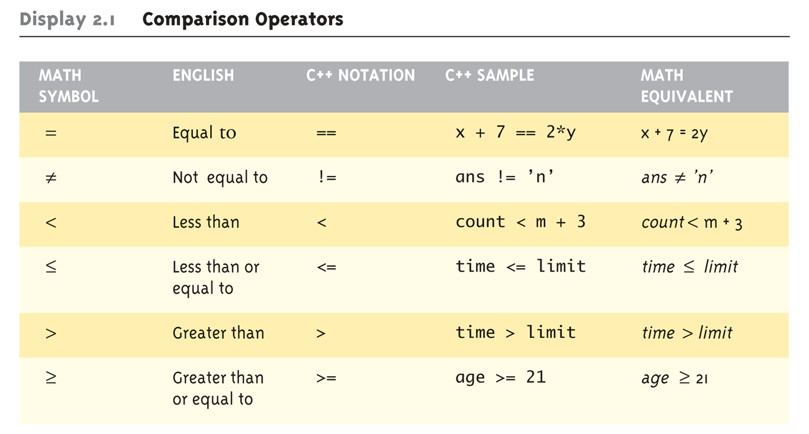
Getting Logical : Boolean Expressions
Logical Operators
Logical AND (&&)
Logical OR (||)

Slide 5
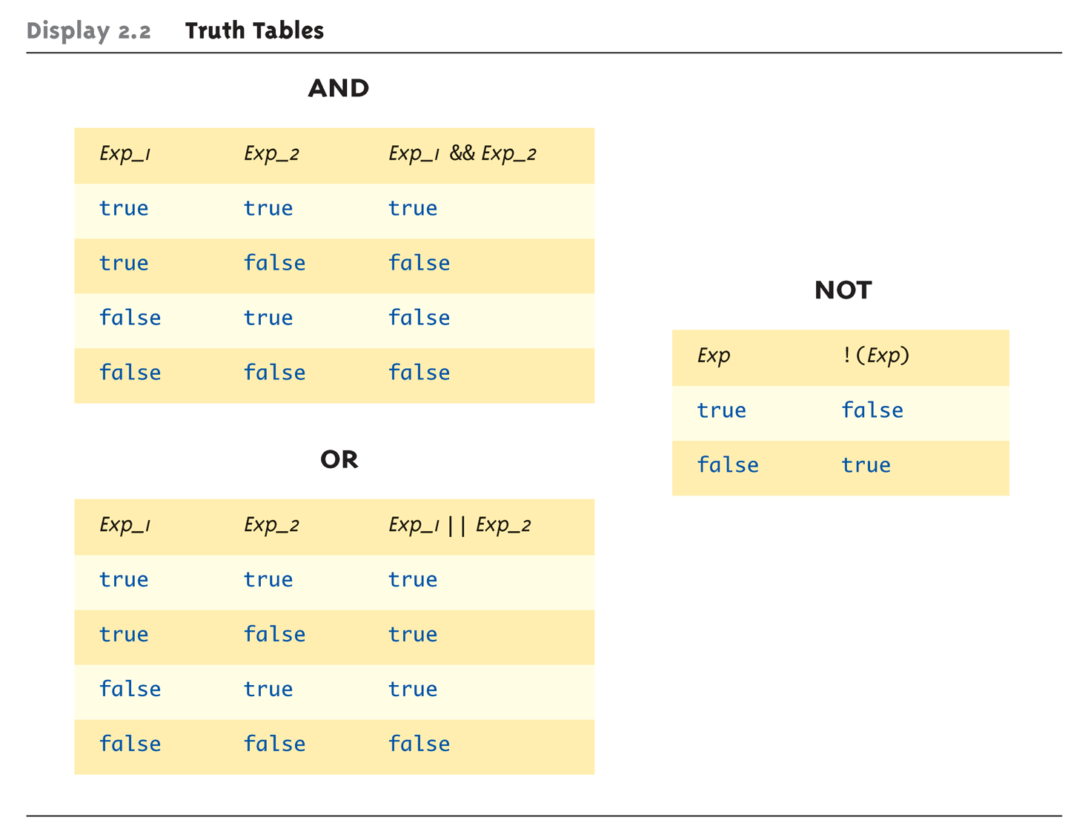
Evaluating Boolean Expressions
Data type bool
Returns true or false
true, false are predefined library consts
Notes:
State capital example

Slide 6
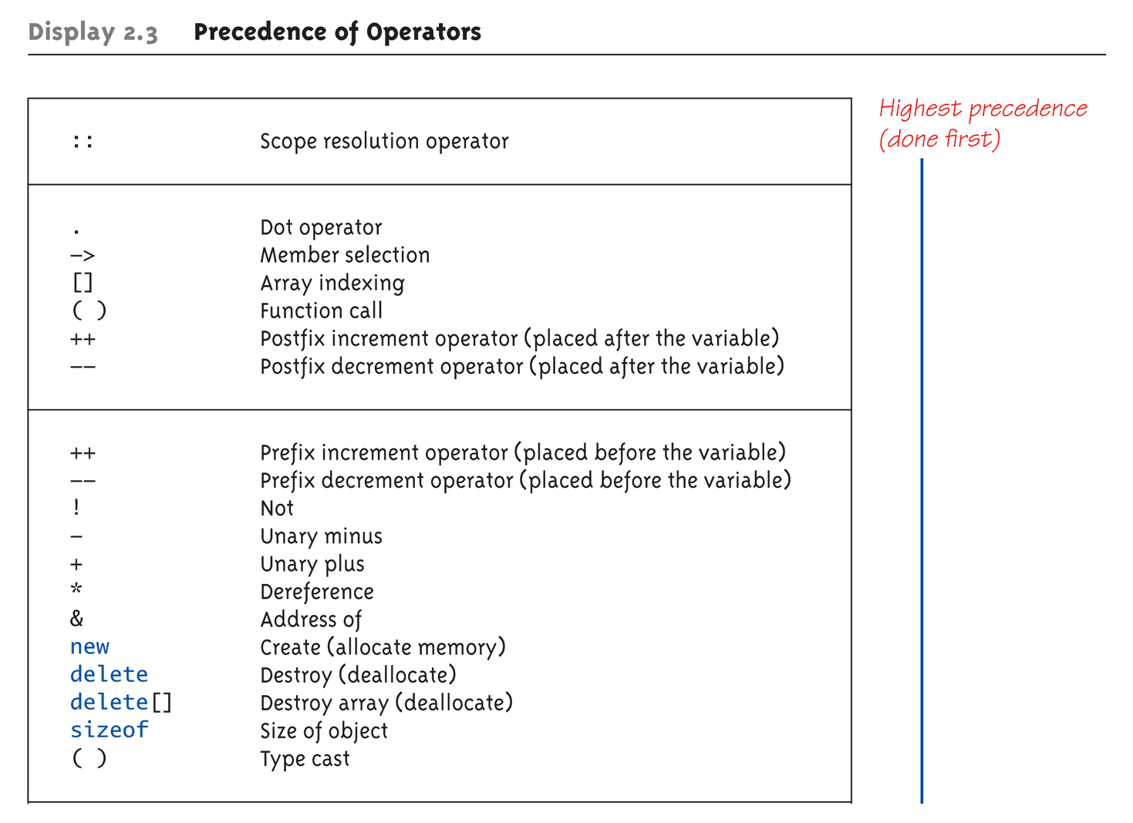
Display 2.3 Precedence of Operators (1 of 4)

Slide 7
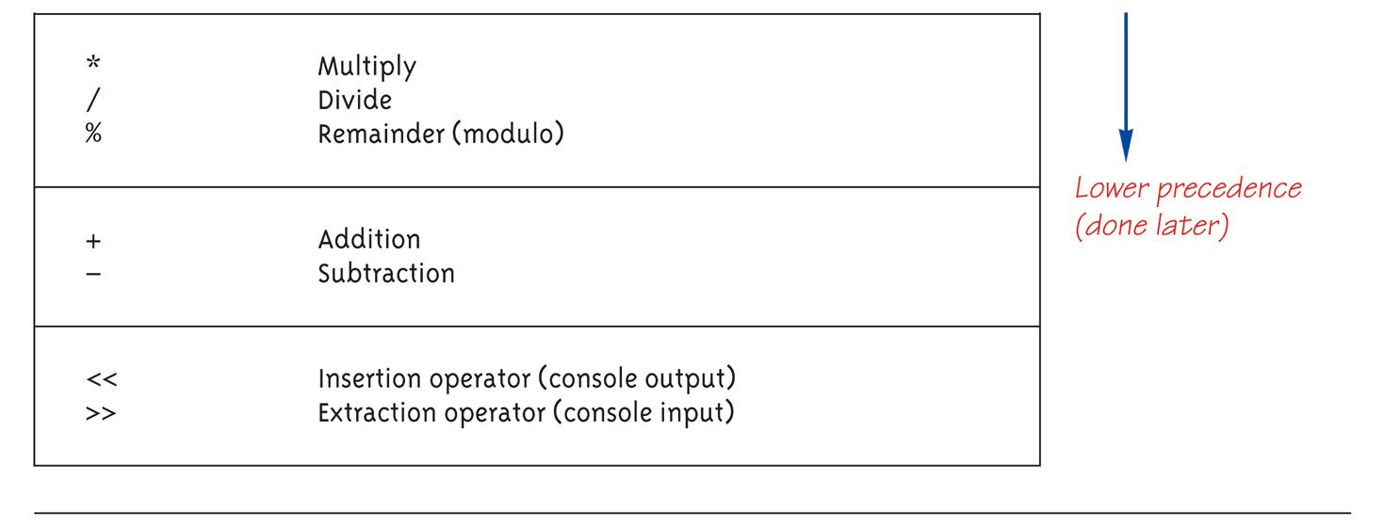
Display 2.3 Precedence of Operators (2 of 4)

Slide 8
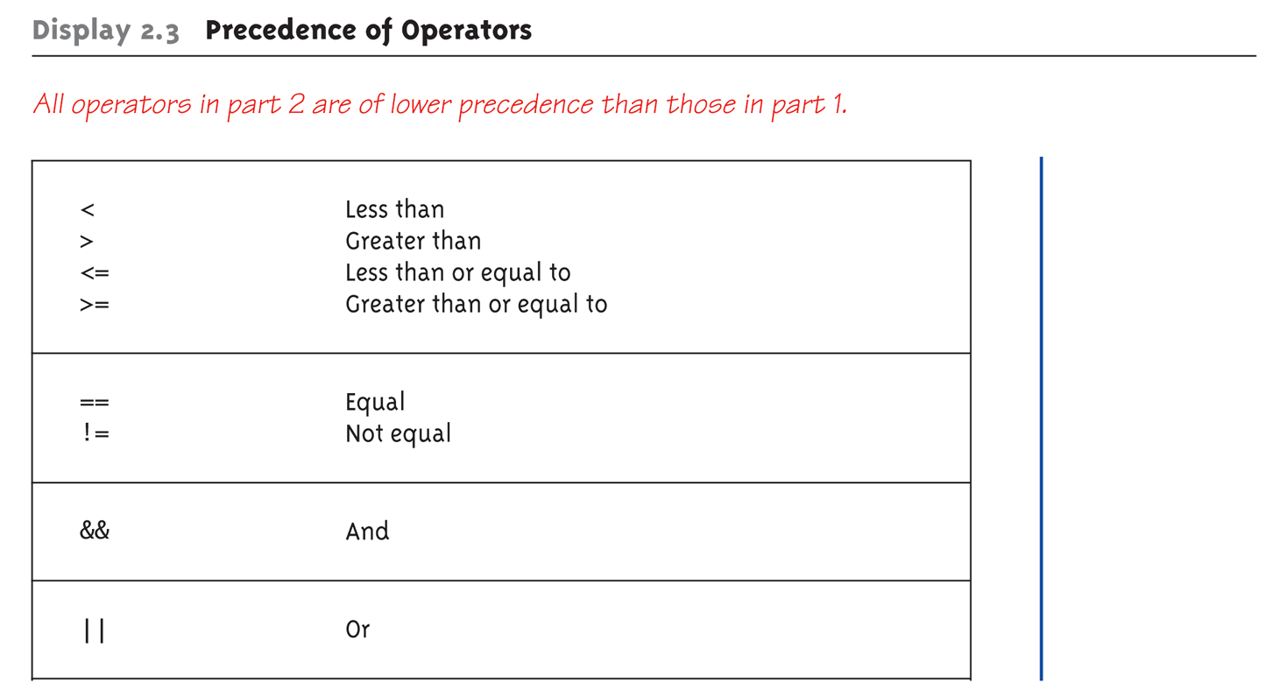
Display 2.3 Precedence of Operators (3 of 4)

Slide 9
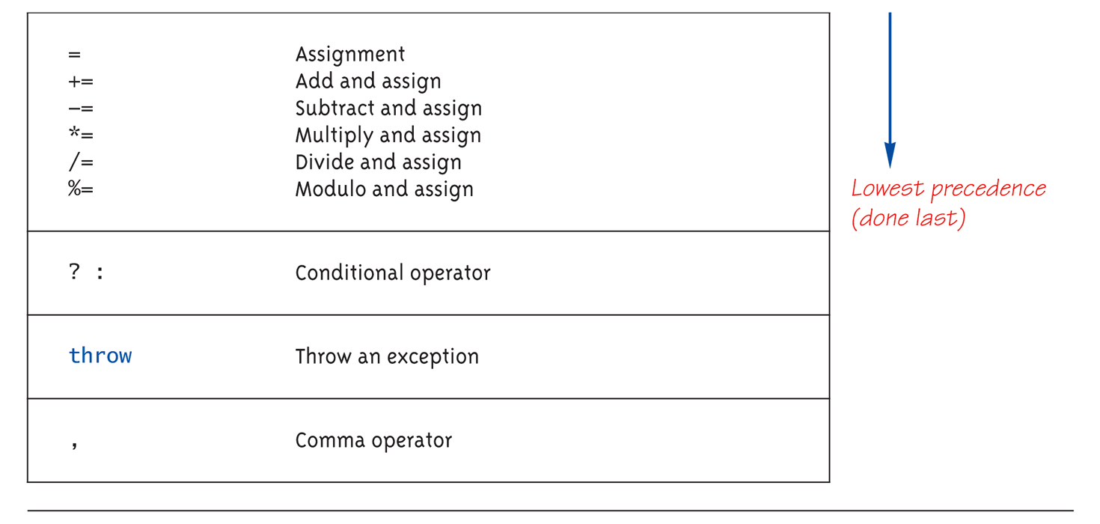
Display 2.3 Precedence of Operators (4 of 4)

Slide 10
Precedence Examples
Arithmetic before logical
x + 1 > 2 || x + 1 < -3 means:
X++ > 0
X = sqrt(16) > 2
Short-circuit evaluation
int x = 1, y = 1;
(x >= 0) || (y++ > 1)
What is value of y?
Integers as boolean values
All non-zero values → true
Zero value → false
Notes:
Arithmetic before logical
x + 1 > 2 || x + 1 < -3 means:
(x + 1) > 2 || (x + 1) < -3
Short-circuit evaluation
(x >= 0) && (y > 1)
Be careful with increment operators!
(x > 1) && (y++)
Integers as boolean values
All non-zero values → true
Zero value → false

Slide 11
Learning Objectives
Boolean Expressions
Building, Evaluating & Precedence Rules
Flow Charts and Pseudo Code
Branching Mechanisms
if-else
switch
Nesting if-else
Debugging and Test Cases

Slide 12
Intro to Flow Charts Basic Shapes
Sheldon’s Friendship Algorithm - http://www.youtube.com/watch?v=k0xgjUhEG3U
Begin Process
Swim Lane
Process Step
Decision Step
Yes
Next Process
Data Store
No
Document
End Process

Slide 13
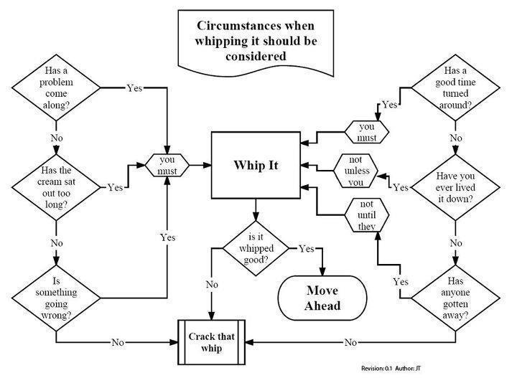
You Can Flowchart Anything
http://www.youtube.com/watch?v=IIEVqFB4WUo

Slide 14
Flowchart Alternative – Pseudo Code
Almost like code
Goal – Capture the logic of the problem you are trying to solve
Ignore syntax issues
Simplify process
Speed up development

Slide 15
Pseudo Code Example Calculate the average of a set of numbers
Set the total and count to zero
Get a number from user
Repeat while the number entered is not zero
Add the number to the total
Increment the count of numbers
Get another number from user
Set the average to equal the total divided by the count of numbers
Display the average.

Slide 16
Learning Objectives
Boolean Expressions
Building, Evaluating & Precedence Rules
Flow Charts and Pseudo Code
Branching Mechanisms
if-else
switch
Nesting if-else
Debugging and Test Cases

Slide 17
Branching Mechanisms
if-else statements
Example: if (hrs > 40) grossPay = rate*40 + 1.5*rate*(hrs-40); else grossPay = rate*hrs;
Hrs > 40
No
Yes
grossPay = regular hours
grossPay = overtime hours
Notes:
Formal syntax: if (<boolean_expression>) <yes_statement> else <no_statement>
Note each alternative is only ONE statement!
To have multiple statements execute in either branch → use compound statement

Slide 18
C++ If-Else Practice
Create a program that calculates over time pay based on previous slide
Create a new project – overtimepay
Remember your #include and using statement
Prompt the user for hours and rate
You can copy and paste the code from slide

Slide 19
Compound/Block Statement
Must use compound statement { } for multiple statements in a branch
Also called a "block" stmt
Each block should have block statement
Even if just one statement
Enhances readability

Slide 20
Compound Statement in Action
Note indenting in this example: if (myScore > yourScore) { cout << "I win!\n"; wager = wager + 100; } else { cout << "I wish these were golf scores.\n"; wager -= 100; }

Slide 21
Common Pitfalls
Operator "=" vs. operator "=="
One means "assignment" (=)
One means "equality" (==)
VERY different in C++!
Example: if (x = 12) ←Note operator used! Do_Something else Do_Something_Else

Slide 22
The Optional else
else clause is optional
If, in the false branch (else), you want "nothing" to happen, leave it out
Example: if (sales >= minimum) salary = salary + bonus; cout << "Salary = %" << salary;
Note: nothing to do for false condition, so there is no else clause!
Execution continues with cout statement

Slide 23
Nested Statements
if-else statements can contain more if-else statements.
Example: if (speed > 65) if (speed > 80) cout << "You’re gonna get pulled over!"; else cout << "You’re driving OK for I-5.";
Note proper indenting!

Slide 24
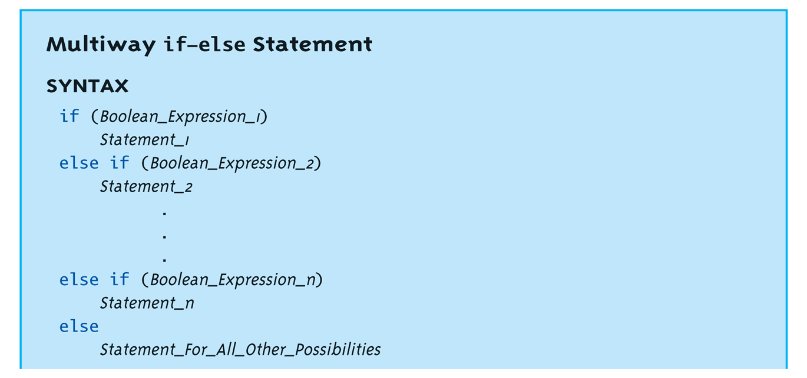
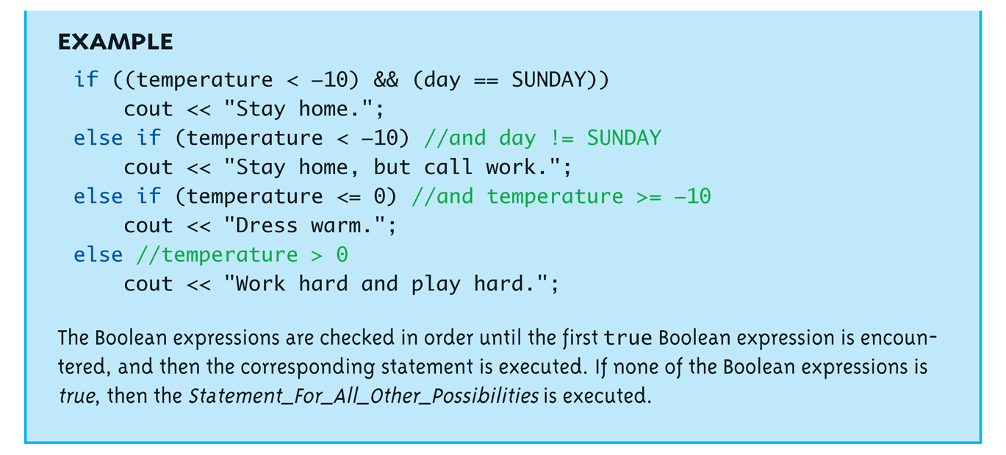
Multiway if-else

Slide 25
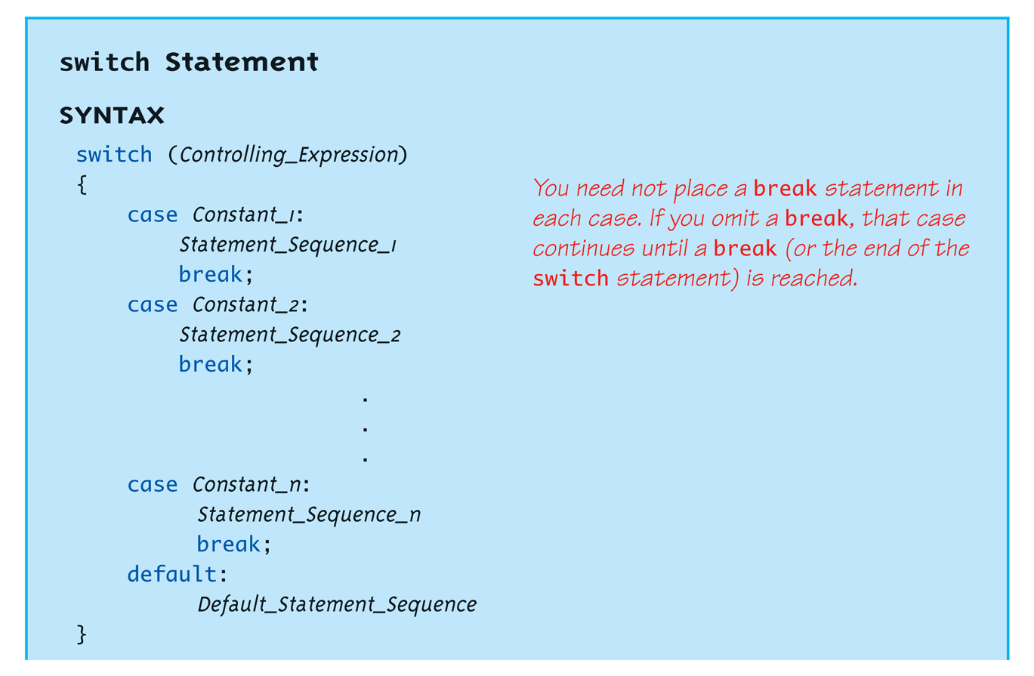
switch Statement Syntax
Note the multiple branches
The controlling expression must be integral! This includes char.

Slide 26
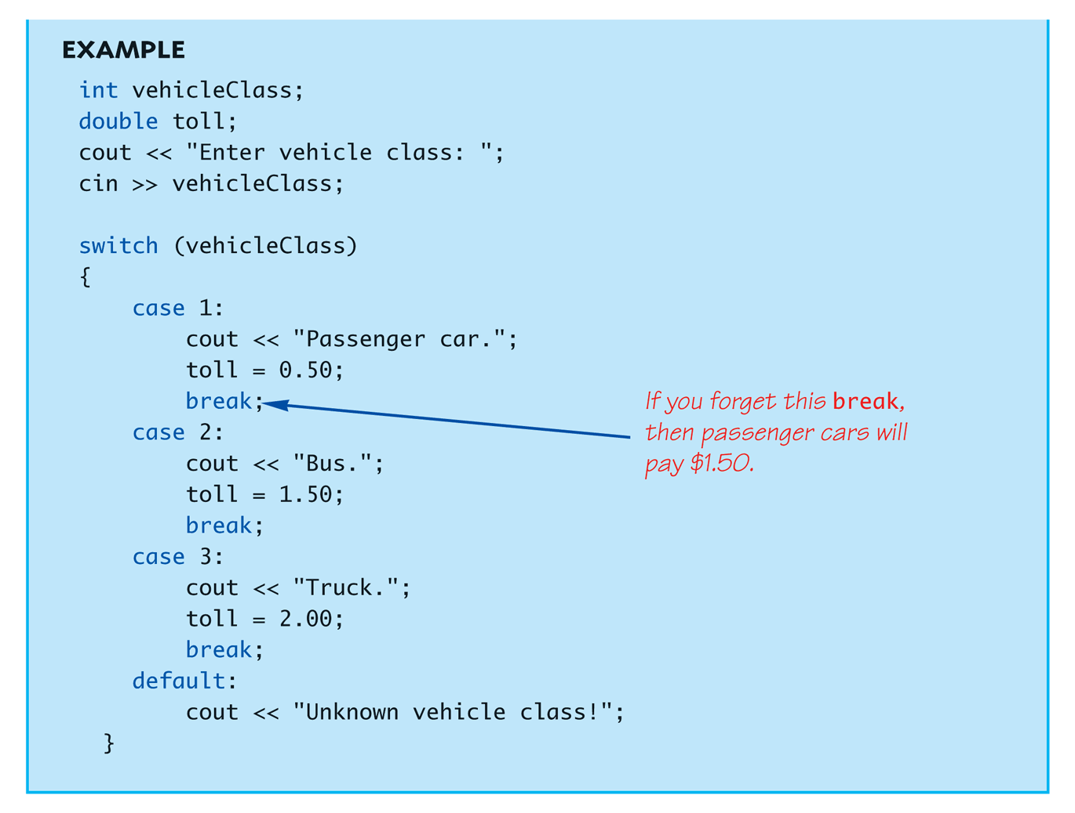
The switch Statement in Action

Slide 27
The switch: multiple case labels
Execution "falls thru" until break
switch provides a "point of entry"
Example: case 'A': case 'a': cout << "Excellent: you got an "A"!\n"; break; case 'B': case 'b': cout << "Good: you got a "B"!\n"; break;
Note multiple labels provide same "entry"

Slide 28
switch Pitfalls/Tip
Forgetting the break;
No compiler error
Execution simply "falls thru" other cases until break;
Biggest use: MENUs
Provides clearer "big-picture" view
Shows menu structure effectively
Each branch is one menu choice

Slide 29
switch Menu Example
Switch stmt "perfect" for menus: switch (response) { case 1: // Execute menu option 1 break; case 2: // Execute menu option 2 break; case 3: // Execute menu option 3 break; default: cout << "Please enter valid response."; }

Slide 30
C++ Switch Practice
Create a new project to print out an employee ranking message
Ask the user to enter a number between 1 and 5
Use a switch statement to print out a message
A value of 5 results in “Exceeds All Objectives” being displayed
4 results in “Exceeds Most Objectives”
2 or 3 results in “Meets Objectives”
1 results in “Does not Meet Objectives”
Anything else should display “Invalid Ranking”

Slide 31
Conditional Operator
Also called "ternary operator"
Allows embedded conditional in expression
Essentially "shorthand if-else" operator
Example: if (n1 > n2) max = n1; else max = n2;
Can be written: max = (n1 > n2) ? N1 : n2;
"?" and ":" form this "ternary" operator
Which alternative “reads easier”?
Which is more efficient?

Slide 32
Learning Objectives
Boolean Expressions
Building, Evaluating & Precedence Rules
Flow Charts and Pseudo Code
Branching Mechanisms
if-else
switch
Nesting if-else
Debugging and Test Cases

Slide 33
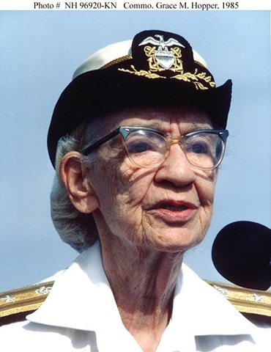
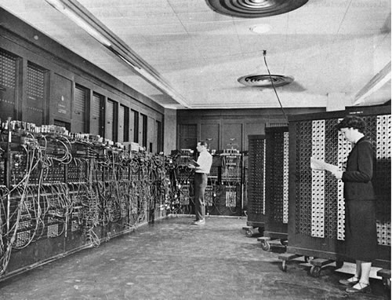
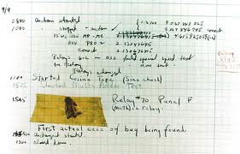
Debugging History
Because stuff happens!!!

Slide 34
Unit Test Plan Concepts Does the Program/Function Work?
Functional
Data Entry – Does Every Field Accept correct data values (Ex. dates, SSN)
Validation Rule Checking (Ex. Start Date <= End Date)
Calculations Executed Properly (Ex. Sales Tax)
Performance
Page Load Time
Page to page navigation quick
Buttons Calculate fast
Security
User Access to pages
Role Setup and Assignment
Hacking Attempts
Notes:
http://templateforfree.com/how-to-write-test-cases/

Slide 35
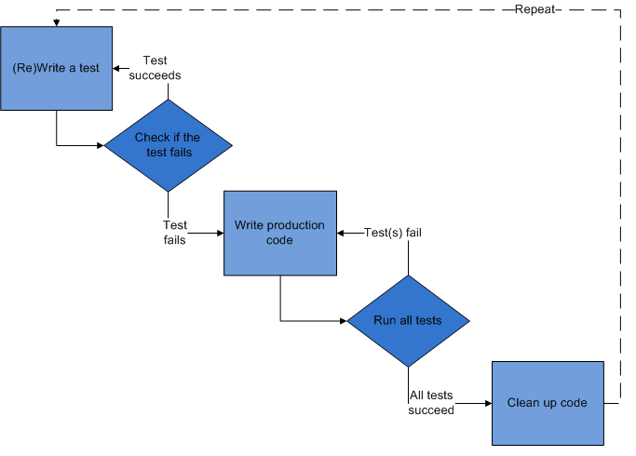
Test Cases and Test First
HP Racial Profiling ☺
https://www.youtube.com/watch?v=t4DT3tQqgRM

Slide 36
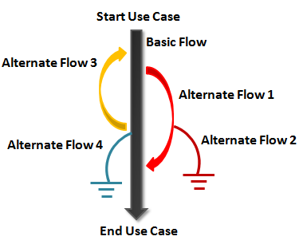
Logic Test Scenarios
Normal Case
Data is valid, user input is OK
Example – Calculate letter grade based on 0-100 score
Boundary Case
User input is OK
Data is at range limit
Example – Score = 100, Score = 92.4
Error Condition
Bad user input
Example – Score = 101, Score =-1

Slide 37
Test Case Template
Purpose of the Test
Pre-Conditions
Post-Conditions
Step | Action | Expected System Response | Pass/ Fail | Comments

Slide 38
Test Case Example Calculating Letter Grade
Purpose of the Test | Verify that test score will calculate the appropriate letter grade result
Pre-Conditions | None
Post-Conditions | All valid scores entered will have received a letter grade.
Step | Action | Expected System Response | Pass/ Fail | Comments
1 | Enter a number 0 < n < 100 | Calculate the appropriate grade
2 | Enter 92.4 | Grade = A-
3 | Enter 100 | Prompt user with invalid entry
4 | Enter -1 | Prompt user with invalid entry
5 | Enter A | Prompt user with invalid entry
Notes:
Note – More complex test cases require establishing the initial conditions and sample data prior to executing the test. This must be specified in the test case.

Slide 39
Syntax Errors in Visual Studio
Find first occurrence of error
Other errors may be a result of the first one
Using the output tab in Visual Studio
Recommend turning on line numbers for editor. Click on Tools → Options → Text Editor → C/C++ → General. Check the Line numbers box.
Double click on the error → brings you to the line in the program

Slide 40
Spot the Mistake!
int x; cout << "Hello World" cin >> x;
cout << "Hello " x ", how are you?\n";
cout >> "Hello World";
#include <isostream>
Notes:
1>c:\users\ebowring\documents\visual studio 2008\projects\aaa\debugging.cpp(8) : error C2146: syntax error : missing ';' before identifier 'cin‘
1>c:\users\ebowring\documents\visual studio 2008\projects\aaa\debugging.cpp(7) : error C2146: syntax error : missing ';' before identifier 'x‘
1>c:\users\ebowring\documents\visual studio 2008\projects\aaa\debugging.cpp(7) : error C2784: 'std::basic_istream<char,_Traits> &std::operator >>(std::basic_istream<char,_Traits> &,unsigned char &)' : could not deduce template argument for 'std::basic_istream<char,_Traits> &' from 'std::ostream'
1>c:\users\ebowring\documents\visual studio 2008\projects\aaa\debugging.cpp(1) : fatal error C1083: Cannot open include file: 'isostream': No such file or directory

Slide 41
Other Common Mistakes
Failing to declare a variable before using it
Undeclared identifier error
Not initializing a variable
Warning message is generated
Brace mismatch
Not using braces on if-then-else

Slide 42
Debugging Main Approaches
Print Statements
Use cout or cerr
Before and after conditions and loops
Code Execution or Program Trace Viewer
Discussed in Week 8

Slide 43
Key Takeaways
What does a Boolean expression result in?
It Depends
If → Then → Else
Switch
Test Early and Test Often!

